Slide 1
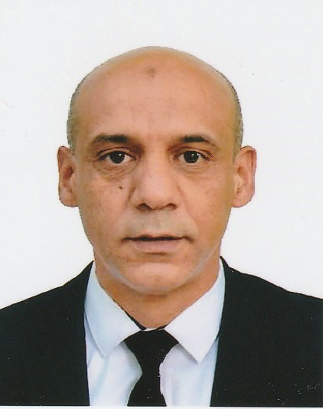

Organizational chart
CEO
CFO
COO
FINANCIAL CONTROLLER
FINANCAL CONTROLLER
CTO
Community Manager
CCOMMERCIAL DIRECTOR
CTO
CM
Head of Sales
Back- End system Manager
Mobil App Coordinator
Help desk and CRM
Vendor Experience Manager
IOT
Hub Algiers
Sales Dept
reviewers

